Slide 1
PROJECT MANAGEMNET
UNIT – 1

Slide 2
What is a project?
A unique undertaking composed of interrelated activities which has a well defined beginning and end , often involving staff from cross-functional groups, that operates under specific constraints of resources, schedules, and requirements
Project : Converting a vision, a dream or a need to reality.
A job that has a beginning and an end (Time)
A specified outcome(Scope)
At a stated level of Performance (Quality)
At a budget(Costs).
Project Characteristics :
Temporary : Has definite Start and Finish
Unique : Product/Service is different in some distinguishing way

Slide 3
Definition
According to Harold Kerzner: A project is any series of activities and tasks that:
• have a specific objective to be completed within certain specifications
• have defined start and end dates
• have funding limits, and
• consume resources.
A Project is A TEMPORARY ENDEAVOR undertaken to create A UNIQUE PRODUCT, SERVICE or RESULT!

Slide 4
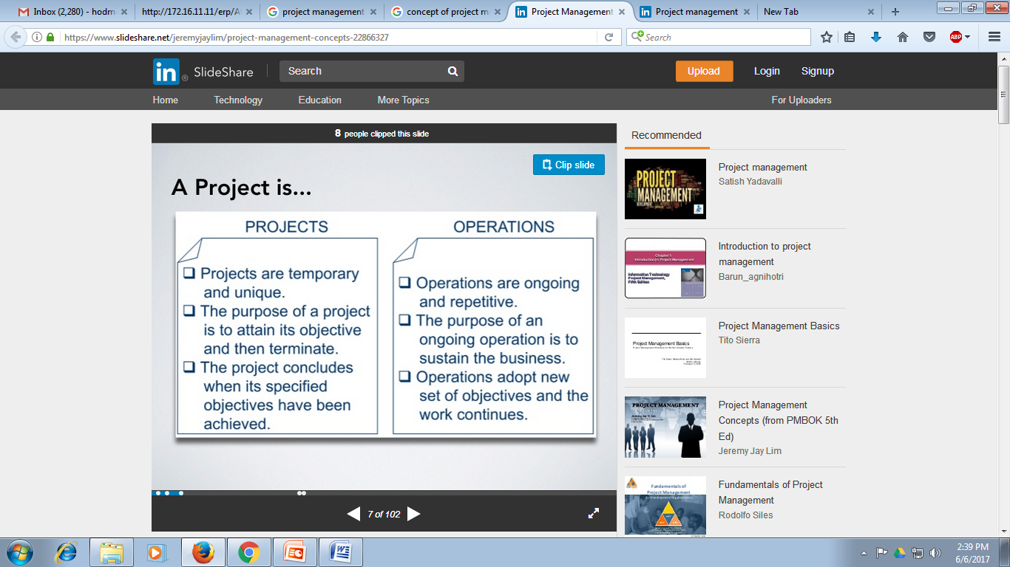

Slide 5
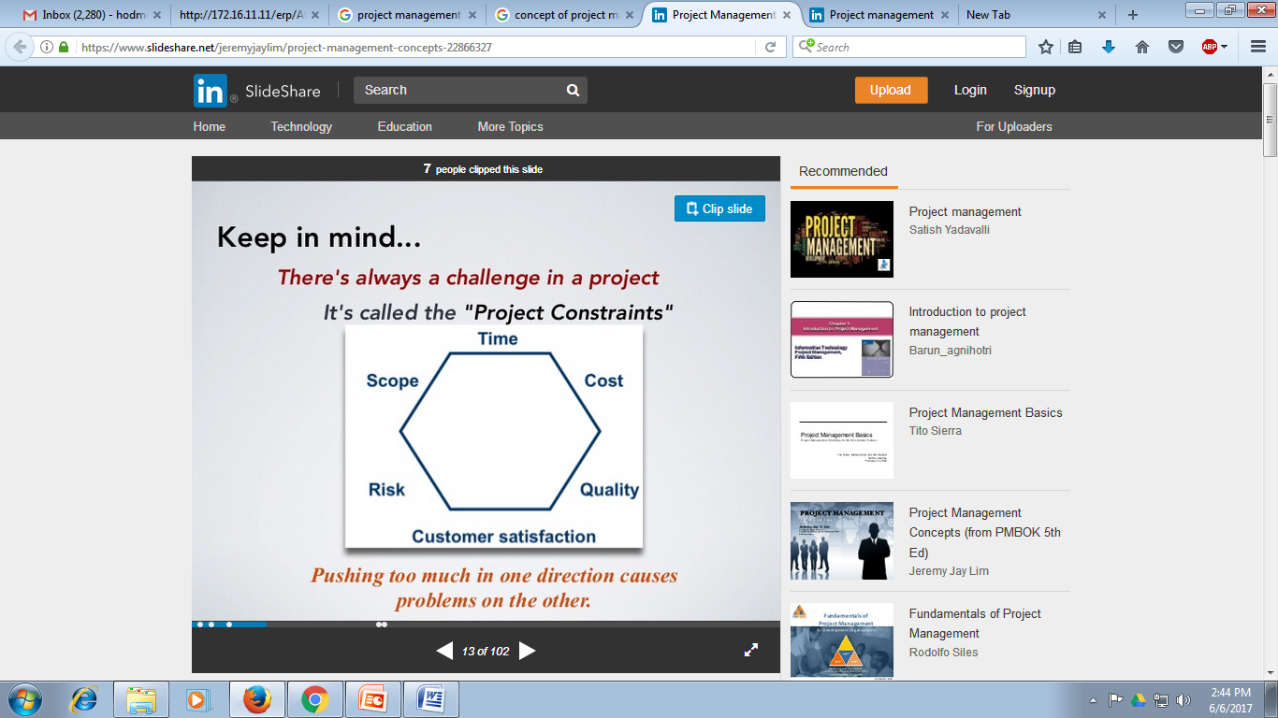

Slide 6
What is project management?
A set of skills and methods of planning, organizing, and managing a project from inception to its successful completion
Application of knowledge, skills , tools & techniques to project activities in order to meet stakeholder needs & expectations from a project.
Needs : stated part of the project
Expectations : unstated part of the project
“Completion of Project on time within Budget without comprising Quality”

Slide 7
Why do companies use PM?
• To handle projects effectively in an organization.
• To define the project and agree with the customer
• To plan and assess resource needs for the project
• To estimate project cost and make proposals
• To plan & schedule activities in a project.
• To allocate the right resource at the right time.
• To assess risk and failure points and make backup plans.
• To lead a project team effectively and communicate well among team members.

Slide 8
Why do people learn PM?
• To explore the latest concepts and techniques of project management.
• To increase value/contribution to the organization. To prove yourself skillful in managing projects.
• To learn a new thought process that helps organized thinking and structured approach.
• To acquire a professional degree/ recognition and increase job prospects.
• Endless possibilities and benefits……..

Slide 9
Characteristics
Objective: Each and every project needs to be guided to achieve an objective or a set of objectives. It ceases to exist when the objective is achieved.
Life Span: A project has beginning and end. It cannot continue forever.
Constraints: A project has a schedule. It operates within the constraints of time, cost and quality. Every project requires certain investment of resources.
Unique: Every project is unique. No two projects are exactly similar.
System: All projects need to undergo a system of inputs-process - Outputs.
Life Cycle: Every project will have its own phase-based cycle.

Slide 10
Characteristics
Teamwork: A project has many participants. It requires teamwork under the leadership of the Project Manager.
Organization Structure: A project is a temporary organization. A project usually has its own budget and management.
Planning and Control System: A project requires information, planning and control system. The actual performance is compared with the planned targets.
Collection of Activities: A project is a collection of activities that are linked together to constitute a system

Slide 11
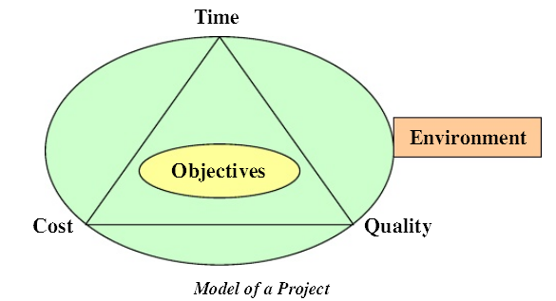
Model of a Project

Slide 12
Benefits of project management
Project management helps to avail the following benefits:
Identification of functional responsibilities to ensure that all activities are accounted for regardless of personnel turnover.
Minimizing the need for continuous reporting.
Identification of time limits for scheduling.
Identification of a methodology for trade-off analysis.
Measurement of accomplishment against plans.
Early identification of problems so that corrective action may follow.
Improved estimating capability for future planning.
Knowing when objectives cannot be met or will be exceeded

Slide 13
Obstacles in project management
To enjoy the various benefits of project management given above, the following obstacles be overcome carefully.
Project complexities
Execution of customer’s special requirements
Organization restructuring is a typical task
Project risks
Changes in technology
Forward planning and pricing.

Slide 14
Project Environment
Environment consists of forces that influence the project’s ability to achieve its objective. Projects operate in a dynamic environment. Project environment can be classified into:
Internal Environment
Internal environment is located within the project. It is Controllable by the project. It provides strengths and weaknesses to the project. The forces in the internal environment consists of:
Project Objective
Constraints
Structure
Resources

Slide 15
Project Environment
Task Environment: The task environment of a project is made up of stakeholders. They are either involved in the project or their interests are affected by the project. The elements of task environment are:
Customer
Contractor
Consultants
Suppliers
Government
Financiers
Competitors
Labour Unions

Slide 16
Project Environment
External Environment
It is located outside the project. It cannot be controlled by the project. The project can indirectly influence it. It provides opportunities and threats to the project. The forces in the external environment are:
Economic
Technological
Political-Legal
Socio-cultural

Slide 17
Functions of Project Management
Scoping – setting the boundaries of the project
Planning – identifying the tasks required to complete the project
Estimating – identifying resources required to complete the project
Scheduling – developing a plan to complete the project
Organizing – making sure members understand their roles and responsibilities
Directing – coordinating the project
Controlling – monitoring progress
Closing – assessing success and failure

Slide 18
Measures of project success: The resulting information system is acceptable to the customers (e.g. users, managers). ▪ The system was delivered ‚on time.‛ ▪ The system was delivered ‚within budget.‛ Measures of project failure: ▪ Failure to establish upper-management commitment to the project ▪ Lack of organization’s commitment to the methodology ▪ Taking shortcuts through or around the methodology ▪ Poor Project management: ✓Feature creep ✓Scope creep

Slide 19
Project Life Cycle - Definition The sequence of phases through which the project will evolve is a project life cycle. A project life cycle is basically defined by it’s phases, according to which a project swims through & finally reaches to handover stage. “The life cycle is the only thing that uniquely distinguishes projects from non- projects.”

Slide 20
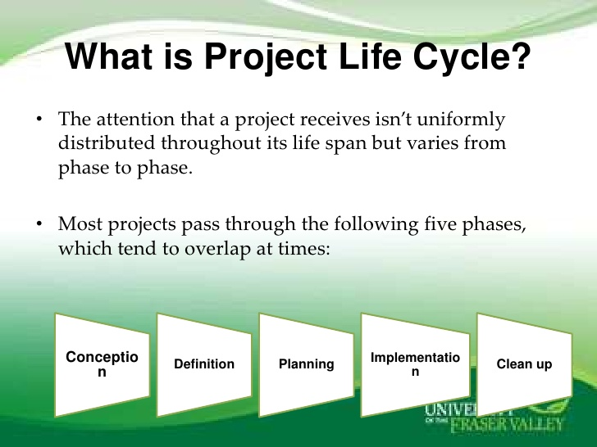

Slide 21
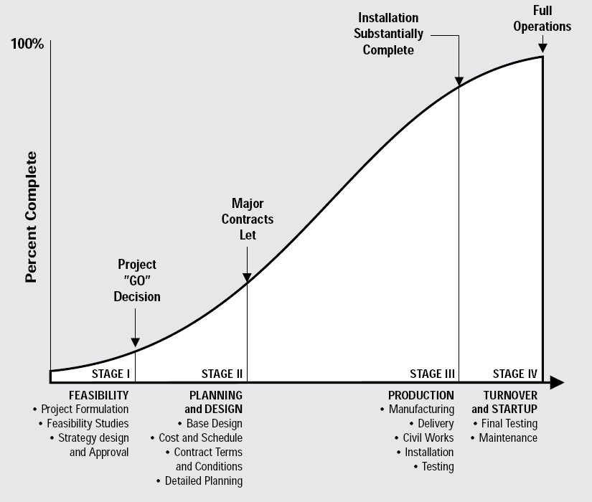
Project life cycle

Slide 22
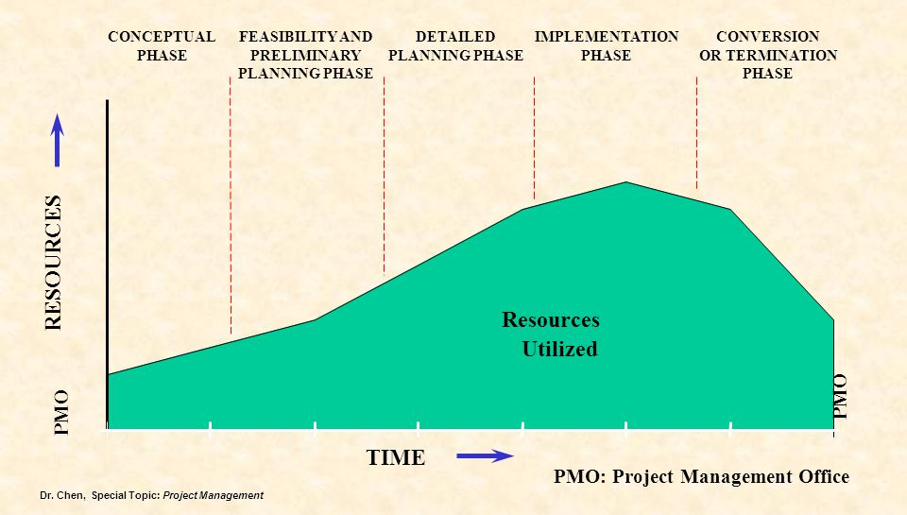
Project Life Cycle

Slide 23
Conception – Phase 1 It is the idea, thought, initial plan, first stage of thinking entrepreneur, manager or economic planner about his scheme, plan for elimination the existing problems in the existing operation or avail new opportunities prevailing. The concept may be to set up a new project or to expand the existing operation or modernize, replace with new concepts or technologies and to initiate action for quality of improvements. Formulation is further firming up of the concepts, ideas, thinking etc for putting the same into a realistic plan. When the concepts about an existing plan become more and more clear, it would become necessary to examine all the aspects related to decision-making for investment aspects may be technical, finance etc.

Slide 24
Definition of the project:
The definition phase of a system is mainly refinements of the elements described in the conception phase. All the sub-systems and elements of the proposed system are scrutinized as defined.
Fabrication of final system performance requirements
Preparing detailed plans
Estimating cost, schedule, and performance
Spotting areas of high risks
Identify and prepare the documents required to system, such as procedures, documents, budgets and finance

Slide 25
The areas to be examined during this phase
Raw materials
Plant size and capacity
Location and site
Technology/Process selection
Project layout
Plant and machinery
Electrical and instrumentation works
Civil Engineering works
Utilities
Financial analysis
Implementation schedule

Slide 26
Planning and Organizing phase
Starts immediately after the conception phase
Overlaps definition phase and implementation phase
Preparation of Project execution plan to mark this phase
Necessary action to be taken in this phase
Project infrastructure and enabling services
System design and basic engineering package
Organization and manpower
Schedules and budgets
Licensing and governmental clearances
Finance
Systems and procedure
Identification of project manager
Design basis, general conditions for purchase and contracts
Site preparation and investigation
Construction resources and materials

Slide 27
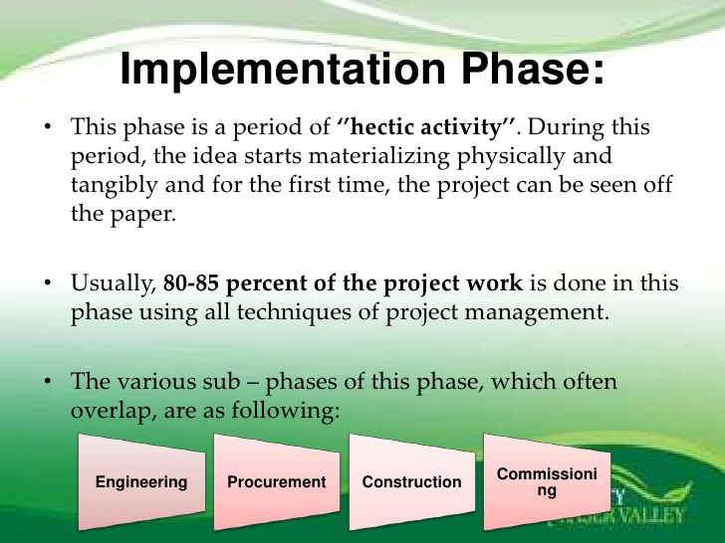

Slide 28
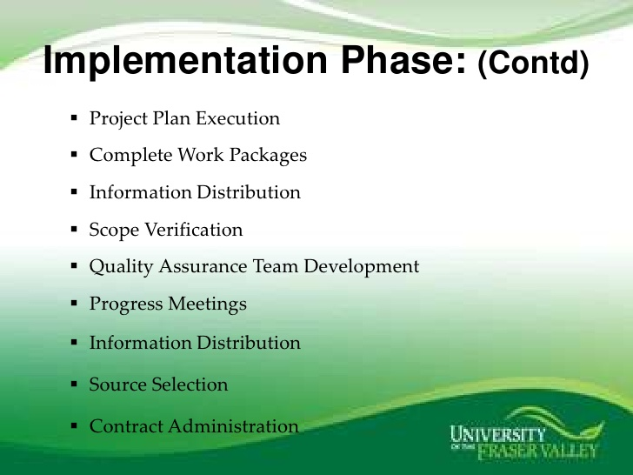

Slide 29
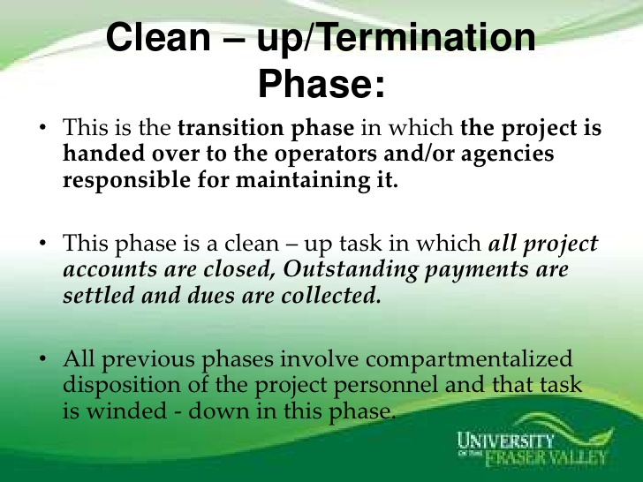

Slide 30
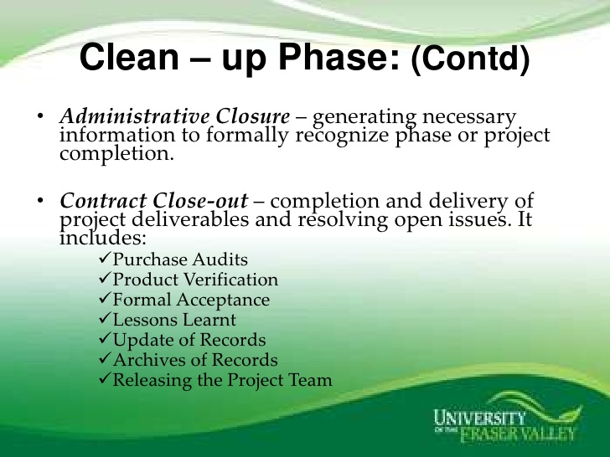

Slide 31
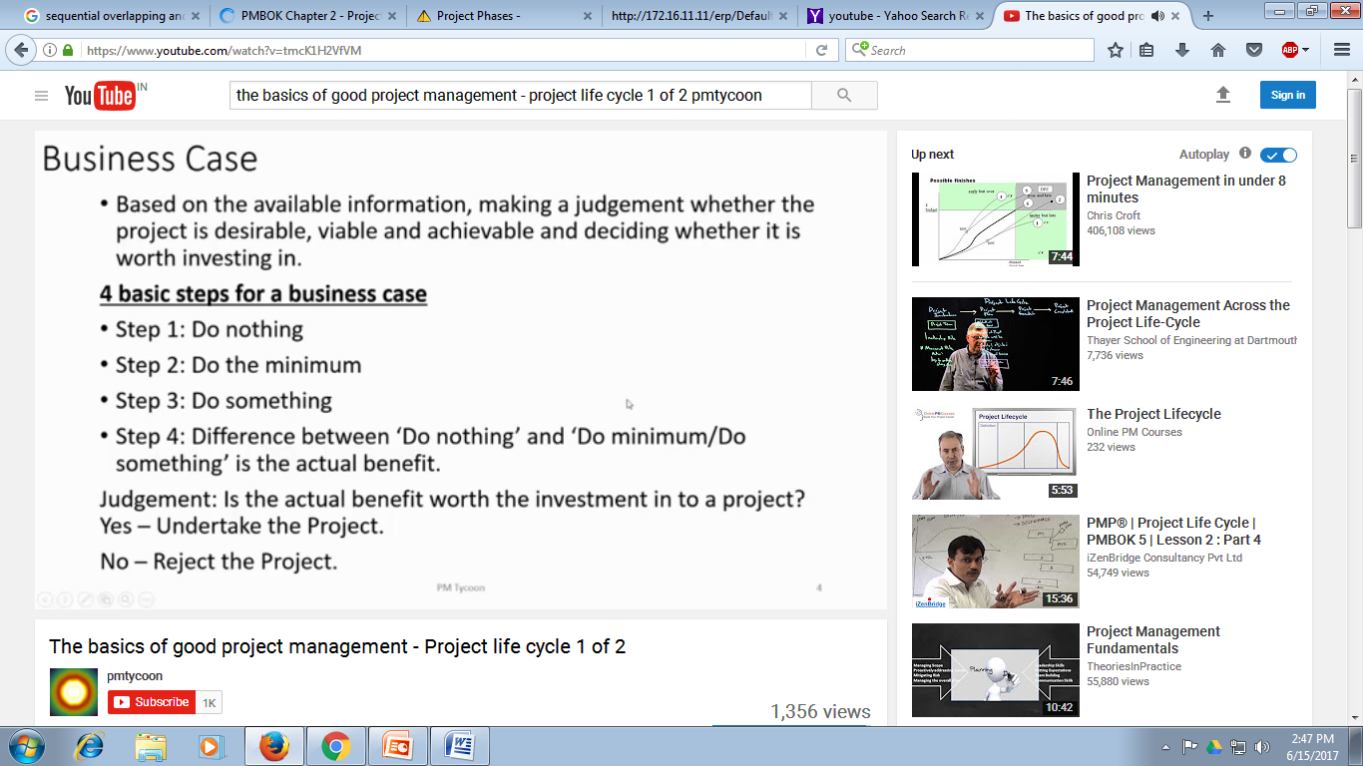

Slide 32
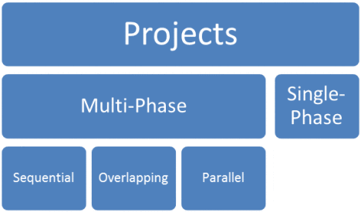
Types of Project life cycle phases

Slide 33
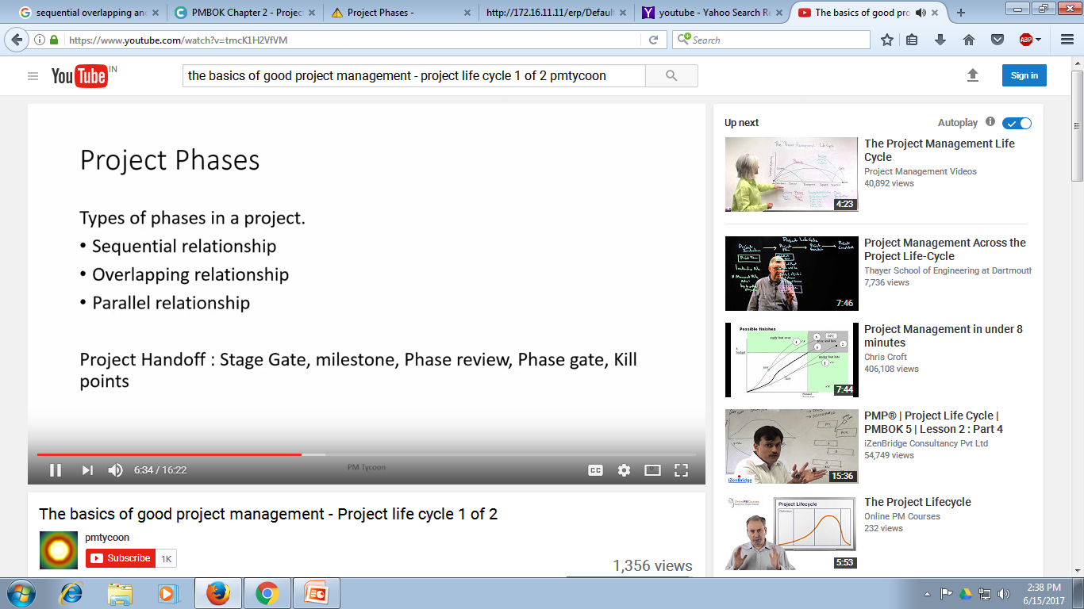

Slide 34
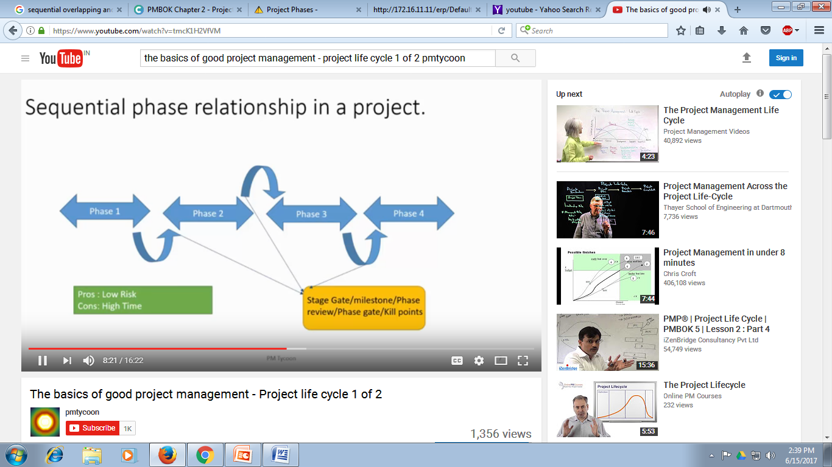

Slide 35
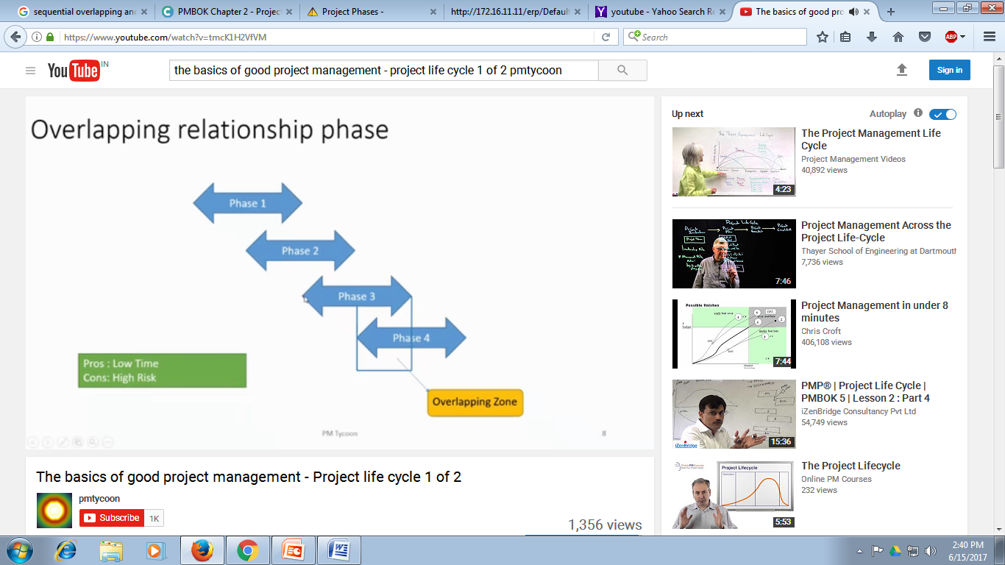

Slide 36
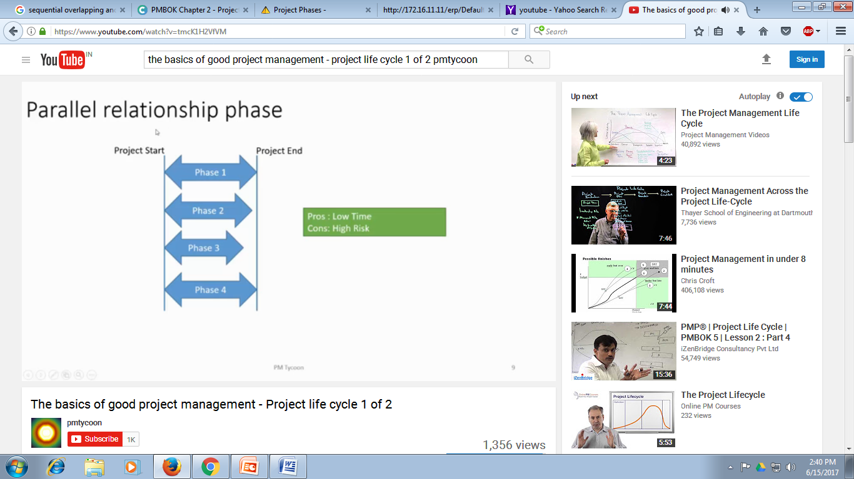

Slide 37
Project Organization
Project Organization consists of:
Designing a Structure
Pulling together Project Team
Establishing Authority and Responsibility relationship
Establishing Project Office
There are three major organizational forms commonly used to house the projects.
Functional Organization
Pure Project Organization
Matrix Organization

Slide 38
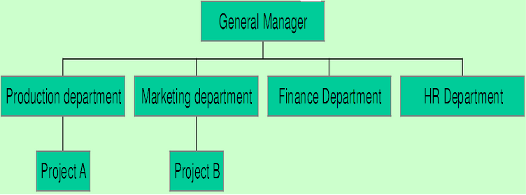
1 Functional Organization
Organization structure is broken into different functional units.
The project tasks are performed through functional units.
A project tends to be assigned to the functional unit that has most interest in ensuring its success or that can be most helpful in implementing it.
Functional elements of the parent organization- Administrative home for a project

Slide 39
Advantages:
There is maximum Flexibility in the use of staffs.
Individual experts can be utilized by many projects
Specialists in the division can be grouped to share knowledge and experience--Synergistic solutions to technical problems
Serves as a base of technological, procedural, administrative and overall policy continuity.
Functional division contains the normal path of advancement for individuals whose Expertise is in the functional area.
Disadvantages:
Lack of Client/Project focus. Focus on unique area of interest.
Decision delay
No individual is given full responsibility- lack of co-ordination
Tendency to sub optimize the project
Weak motivation for people
Does not facilitate a holistic approach to the project (e.g. Jet air craft/ emergency room in a hospital cannot be well designed unless designed as a totality.)

Slide 40
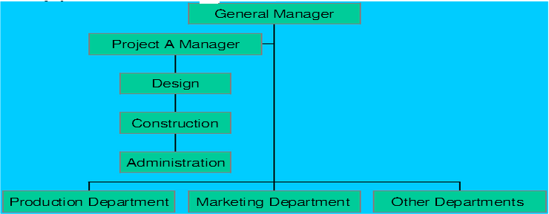
2 Pure Project Organization
O The project is separated from the rest of the parent system.
O A self- contained unit with its own technical staff/ administration.
O The project manager has his own line organization with project authority and responsibility.
O The project has its own resources and management

Slide 41
Advantages:
The PM has full line authority over the project
Project work force directly responsible to the PM
Line of communication- shortened.
Focus on project objective
High motivation
Unity of command Exists
Flexible labor force
Disadvantages:
Duplications of efforts/Inefficient use of resources
Lack of job security
Stock piling of equipments / Technical expertise
Projectiles (A disease-that creates animosities between parent organization. staff and project staff)

Slide 42
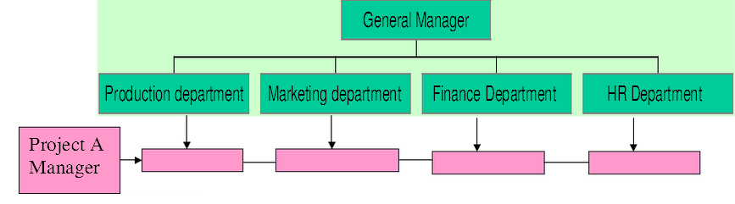
3. Matrix Organization
A combination of pure project organization and functional Organization
It is a pure project organization overlaid on the functional divisions of the parent firm.
Project team is assigned from the functional departments.
The PM has overall responsibility

Slide 43
Advantages:
The project is the point of emphasis/ special focus
Availability of entire reservoir of technical talents in the FD
Team identity
Less anxiety about job
Rapid response to client needs
Consistency of policies/ practices/procedures of parent firm
Holistic approach/Balance of resources
Disadvantages:
Power and Authority is balanced. Doubt exists who is in charge
Division of authority and responsibility is complex
Movement of resources from project to project- may foster political infighting among the several PMs.
Projectile is still a serious disease.
Violates the management principle of unity of command.

Slide 44
Tool & Technique Network Diagrams
A flow-chart that illustrates;
The order in which tasks will be performed
Dependencies between tasks
Comprise three elements
Event - sometimes called a milestone e.g. “design begins”, “draft report approved”
Activity - work required to move from one event to another
Span time - the actual calendar time required to complete an activity

Slide 45
Cost Benefit Analysis
Cost-benefit analysis (CBA), sometimes called benefit-cost analysis (BCA), is an economic decision-making approach, used particularly in government and business.
CBA is used in the assessment of whether a proposed project program or policy is worth doing, or to choose between several alternative ones.
It involves comparing the total expected costs of each option against the total expected benefits, to see whether the benefits outweigh the costs, and by how much.
In CBA, benefits and costs are expressed in money terms, and are adjusted for the time value of money so that all flows of benefits and flows of project costs over time (which tend to occur at different points in time) are expressed on a common basis in terms of their "present value.“

Slide 46
Project section techniques:
Cost benefit analysis
Risk and Sensitivity analysis
Project execution planning techniques
Work breakdown structure (WBS)
Project execution plan (PEP)
Project responsibility matrix
Project management manual
Project scheduling and coordinating techniques
Bar charts
Life cycle curves
Line of balance (LOB)
Networking techniques (PERT/CPM)

Slide 47
Project monitoring and progressing techniques
Progress measurement techniques (PROMPT)
Performance monitoring technique (PERMIT) and
Updating, reviewing and reporting technique (URT)
Project cost and productivity control techniques
Productivity budgeting technique
Value engineering
COST/WBS
Project communication and clean-up techniques
Control room
Computerized information systems

Slide 48
Cost-Benefit Analysis
Accurately estimate all benefits
identify overall profit impact
in net present terms
Accurately estimate all costs
overall profit impact, in net present terms
RATIO: benefits/costs
<=1, don’t adopt >1, profitable
can adopt by highest ratio
Notes:
Cost-benefit analysis is the soundest theoretical approach, but often highly suspect numbers are the only estimates available for benefits, or even costs.

Slide 49
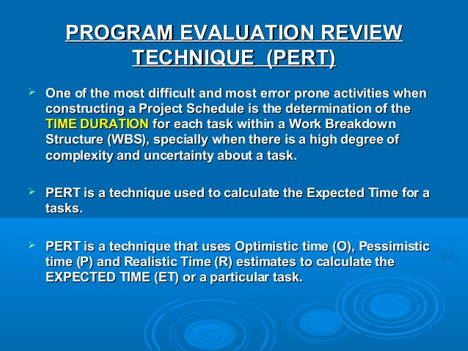

Slide 50
Tool & Technique Activity-in-the-Box Network Diagrams (precedence)
Activity 1 t₁ = 5
Activity 2 t₂ = 1
END
START
Activity 3 t₃ = 1
Activity 4 t₄ = 3
Activity 5
t₅ = 2
All inputs to an activity box must have been completed before it can begin.
E.g. Activity 1 and 4 must be completed before 5 can commence. Critical Path is red

Slide 51
Activity-in-the-Box Network Diagram (Making the Tea)
Re-Boil
10s
START
Fill Kettle
Switch Kettle On
Boil Water (Initial)
Scold Pot
Put Tea-bag In
Pour Water
Place Pot On Tray
10s
3s
180s
10s
5s
15s
5s
Put Milk In Jug
Put Sugar In Bowl
Get Tray
Put Milk, Sugar, Cup & Saucer on Tray
Serve
END TEA SERVED
15s
15s
10s
10s
20s

Slide 52
Gantt Chart
Named after its originator Henry Gantt.
A Gantt chart is a graph which illustrates on a timeline when each activity will start, finish and end. It’s a pictorial representation of each stage of the project.
A GANTT Chart is a horizontal bar chart that illustrates a Project schedule.
In the GANTT Chart Time is displayed on the horizontal axis and the Tasks/ Activities are arranged vertically from top to bottom, in order of their start dates.

Slide 53
Tool & Technique The Gantt Chart

Slide 54
Tool & Technique Critical Path Analysis (for Making the Tea)
Re-Boil
10s
START
Fill Kettle
Switch Kettle On
Boil Water (Initial)
Scold Pot
Put Tea-bag In
Pour Water
Place Pot On Tray
10s
3s
180s
10s
5s
15s
5s
Put Milk In Jug
Put Sugar In Bowl
Get Tray
Put Milk, Sugar, Cup & Saucer on Tray
Serve
END TEA SERVED
15s
15s
10s
10s
20s
Critical Path
TOTAL TIME = TIME ON CRITICAL PATH = 253 secs

Slide 55
Effect of Resource Changes New Technology!
Re-Boil
1s
START
Fill Kettle
Switch Kettle On
Boil Water (Initial)
Scold Pot
Put Tea-bag In
Pour Water
Place Pot On Tray
10s
3s
10s
10s
5s
15s
5s
Put Milk In Jug
Put Sugar In Bowl
Get Tray
Put Milk, Sugar, Cup & Saucer on Tray
Serve
END TEA SERVED
15s
15s
10s
10s
20s
Resource Change
TOTAL TIME = TIME ON CRITICAL PATH = 83 secs
Strictly speaking not possible as needs 2 people
Critical Path

Slide 56
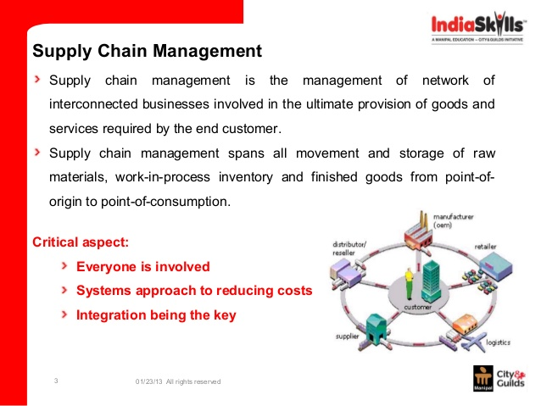

Slide 57
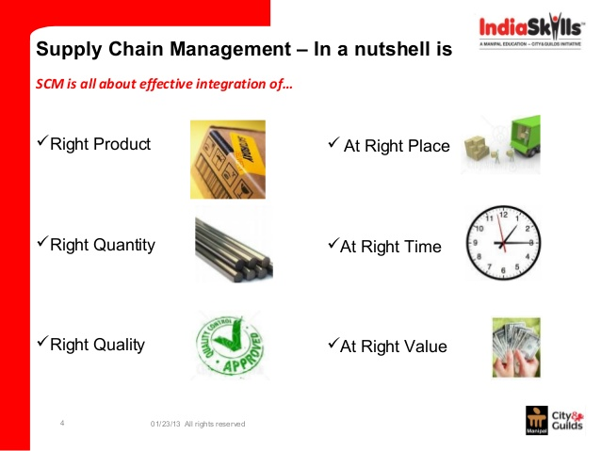

Slide 58
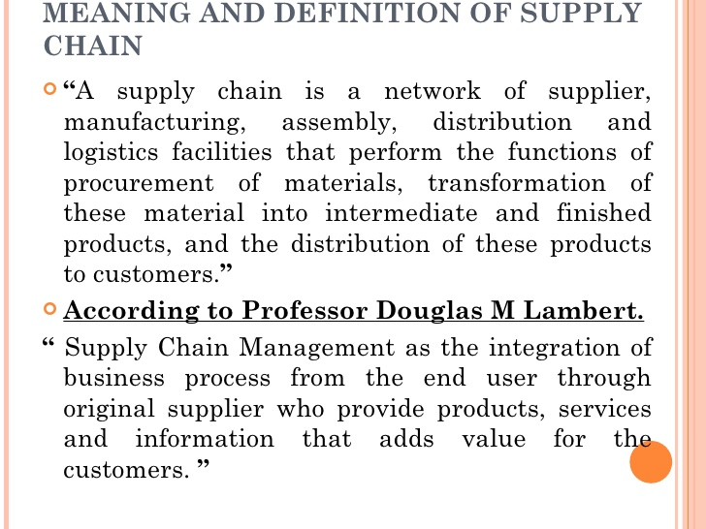

Slide 59
Relating marketing channels, logistics management, and supply chain management

Slide 60
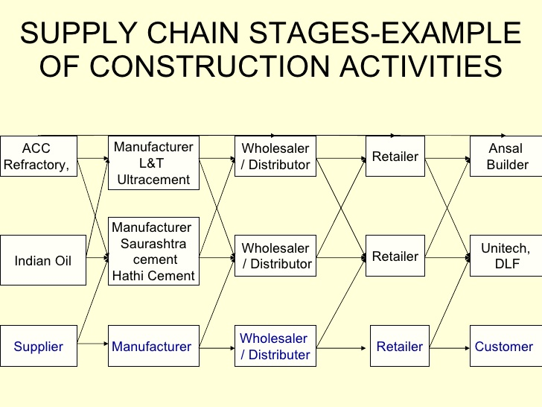

Slide 61
The automotive supply chain

Slide 62
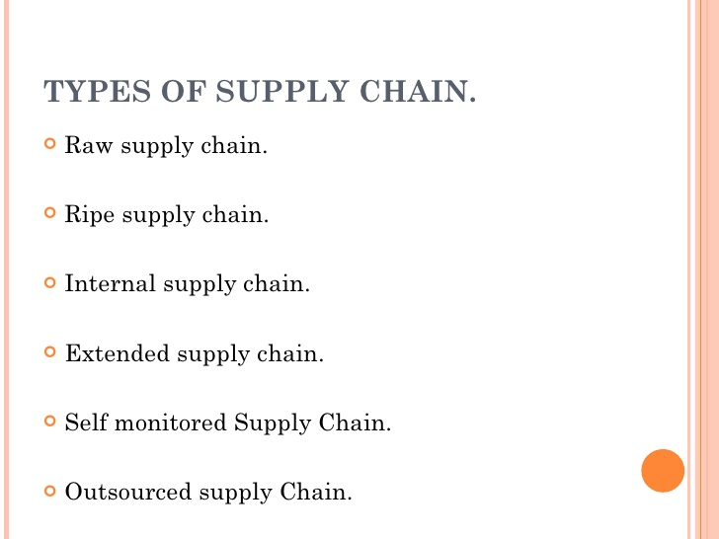

Slide 63
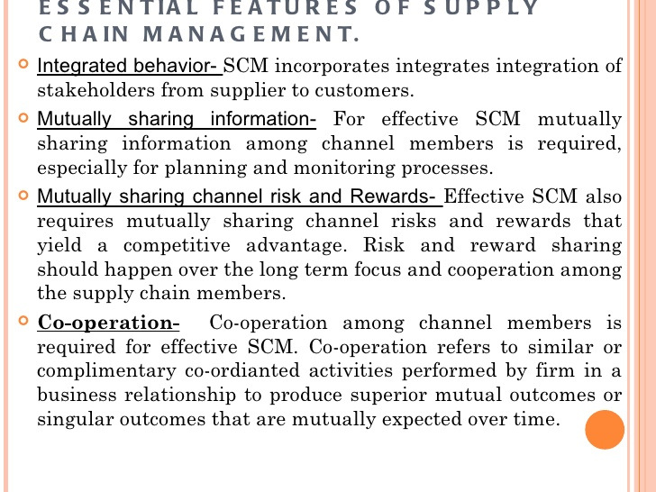

Slide 64
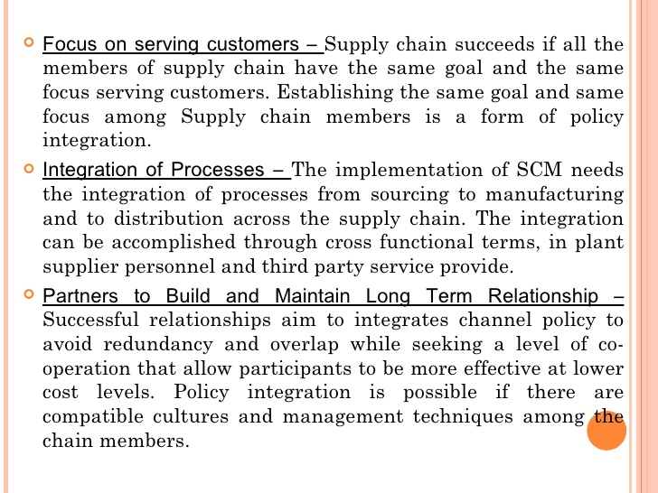

Slide 65
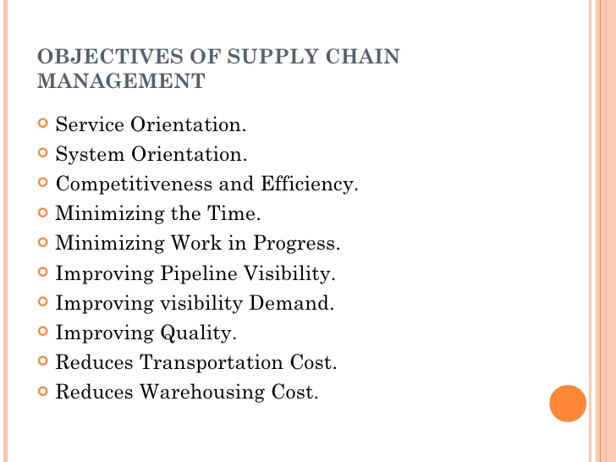

Slide 66
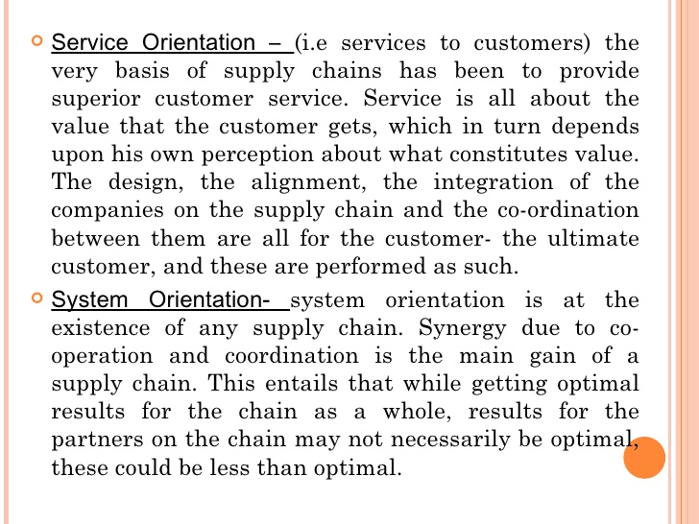

Slide 67
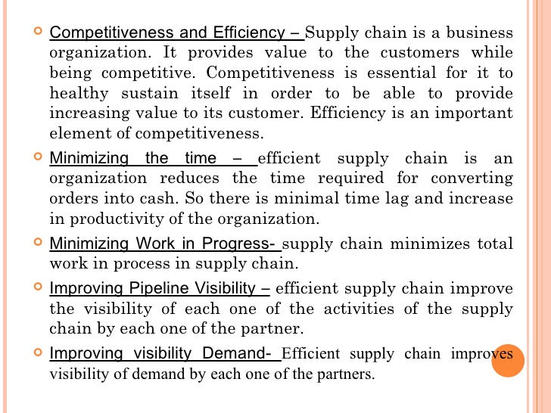

Slide 68
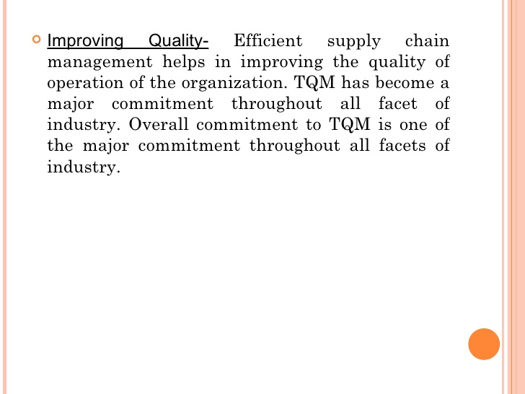
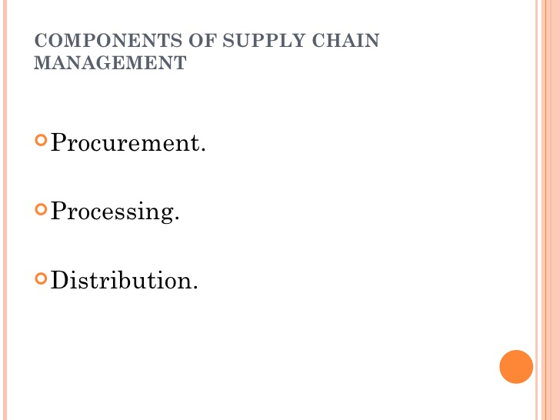

Slide 69
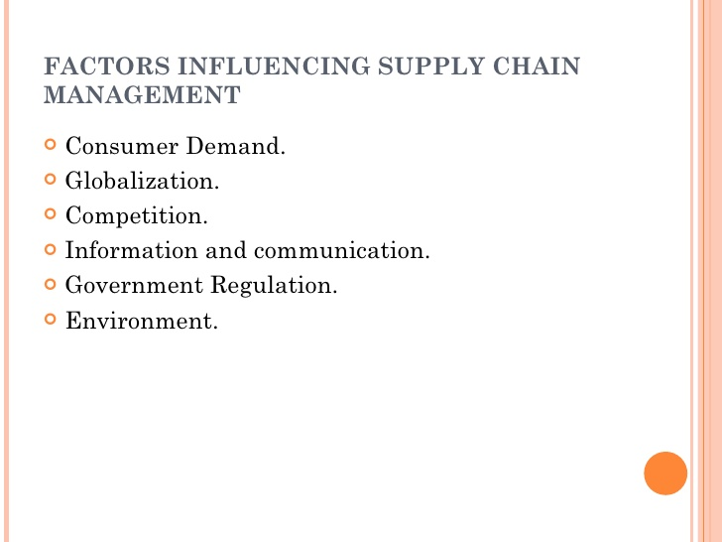

Slide 70
Advantages of Supply Chain Management :
1. helps to increase savings in labour and procurement costs.
2. helps to achieve better inventory control.
3. is used to get better control over suppliers.
4. can increase market visibility.
5. Chances of product failure rate can be reduced
6. is used to provide better information on customer needs, tastes etc.,
7. helps to achieve regular and better communication with the customers.
8. helps to improve customer care service.
9. is used to achieve higher revenues.
10. increases performance and profitability.

Slide 71
Advantages of Supply Chain Management : (Contd.)
11. is used to lower transportation, warehousing and packaging costs.
12. increases capacity, capability or flexibility.
13. enhances value for money.
14. is used to improve reputation of brand in market.
15. also increases the value of shareholder.
16. is used for faster and more accurate order processing.
17.allows higher discount on price to wholesaler due large order size.
18. is also good for returns and recall management.
19. is used for production tracking.

Slide 72
Disadvantages of Supply Chain Management :
1. Sometimes Supply Chain Management can be very expensive to implement.
2. Competitors can easily copy the strategy of Supply Chain Management.
3. For better Supply Chain Management, proper skills and experience is required to achieve success.
4. Sometimes in Supply Chain Management various functions may be difficult to manage.
5. In Supply Chain Management there may be staff resistance.

Slide 73
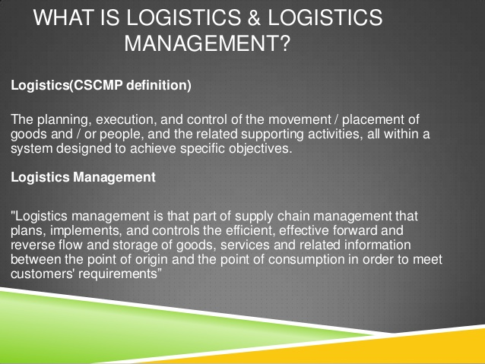

Slide 74
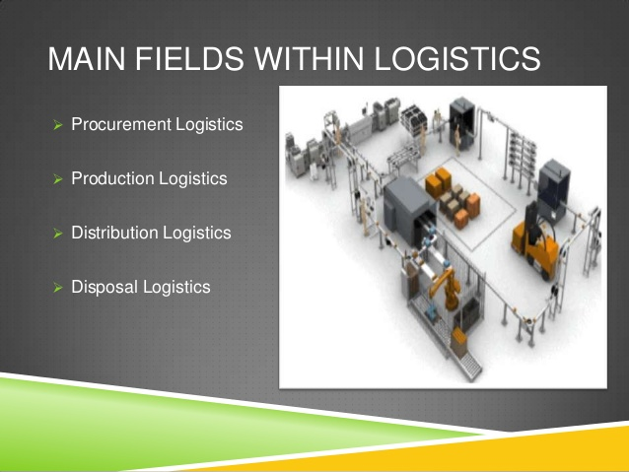

Slide 75
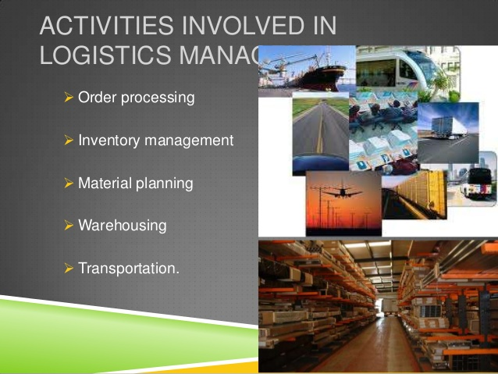

Slide 76
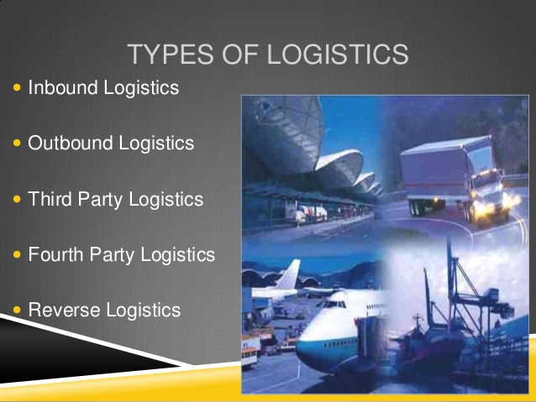

Slide 78
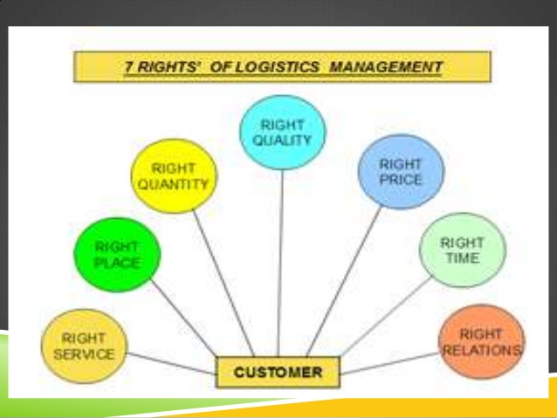

Slide 79
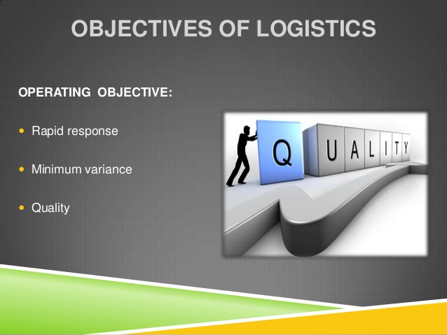

Slide 80
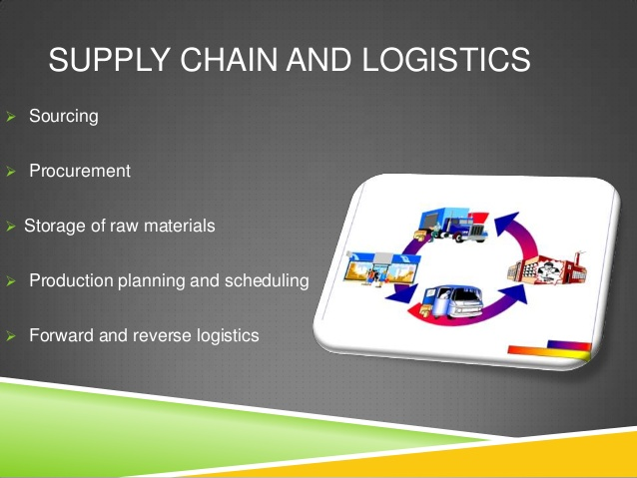

Slide 81
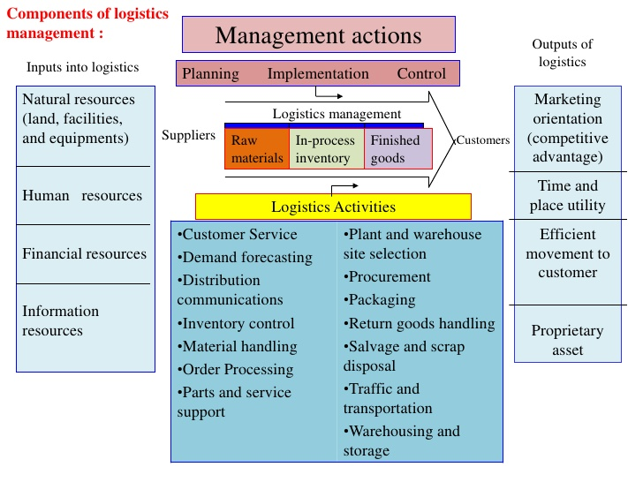

Slide 82
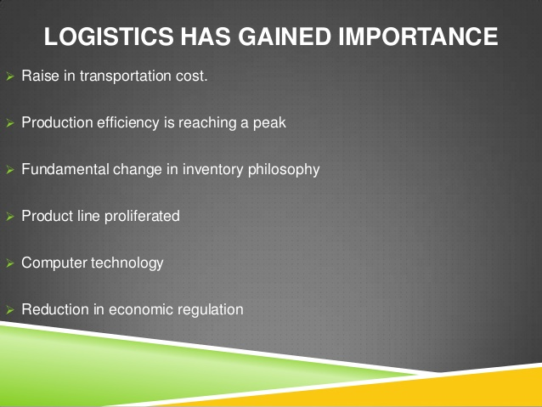

Slide 83
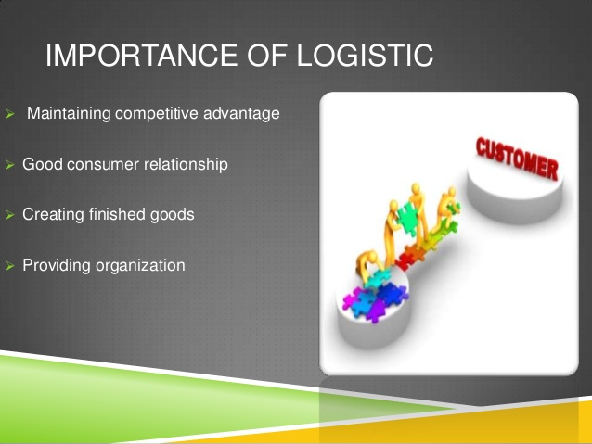

Slide 84
Supply chain Management | Logistics Management
Broader concept | Narrower concept
New concept | Older concept
Extension of Logistics management | Part of supply chain management
Internal integration by itself | Optimizing flows within the organization
It focuses upon the management of relationships in order to achieve a more profitable outcome for all parties in the chain | It focuses upon the management of resources with the organization

